Slide 1
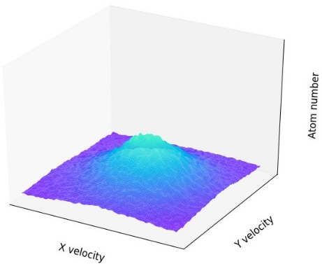
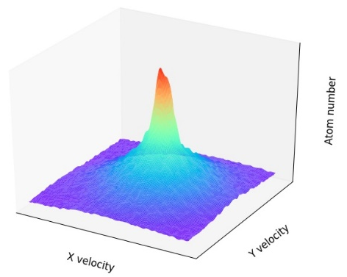
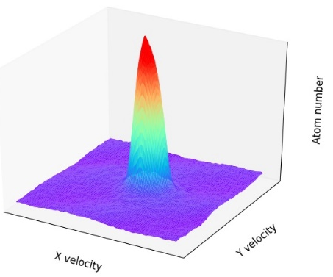
(a)
(b)
(c)
Notes:
Say all axes, including Z
Say center of the peak is zero velocity

